Slide 1
Rehashing, Cuckoo Hashing, Cichelli’s Algorithm

Slide 2
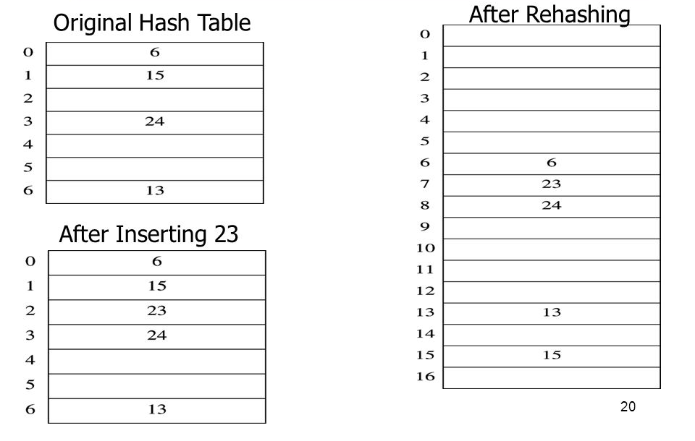
Rehashing
What if you run out of space in the hash table, or the table is so full that finding an empty slot is very hard?
Rehashing: create a new larger hash table, and copy the elements over
Same or different hash function with the new T can be used
Double the size, or, even better, choose new T = large prime closest to old T * 2
h(K) = K % 7
h(K) = K % 17

Slide 3
Cuckoo hashing
Collision resolution algorithm invented in 2001
Guaranteed O(1) look-up time for all entries
Two hash tables are used, each associated with its own hash function
Each K can be either in one or in other table
k | h(k) | h'(k)
20 | 9 | 1
50 | 6 | 4
53 | 9 | 4
75 | 9 | 6
100 | 1 | 9
67 | 1 | 6
105 | 6 | 9
3 | 3 | 0
36 | 3 | 3
0
1
2
3
4
5
6
7
8
9
10
0
1
2
3
4
5
6
7
8
9
10
h(K) = K % 11
100
67
h’(K) = (K / 11) % 11
3
36
53
Problem: cuckoo hashing may produce an infinite loop
50
105
Add max iteration number to the algorithm; in case of deadlock, rehash both tables
20
75
53

Slide 4
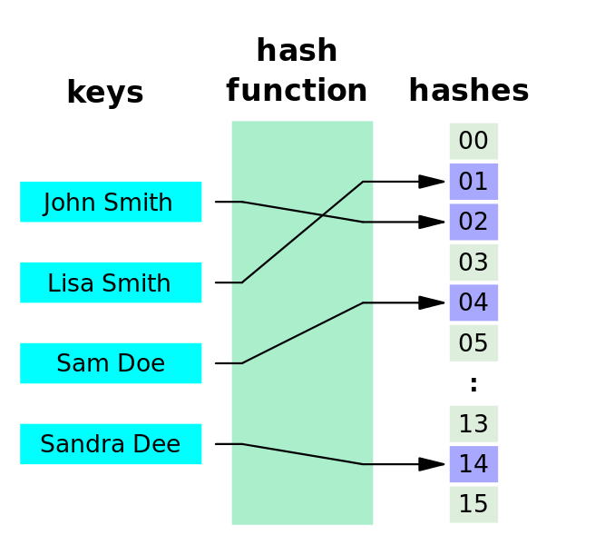
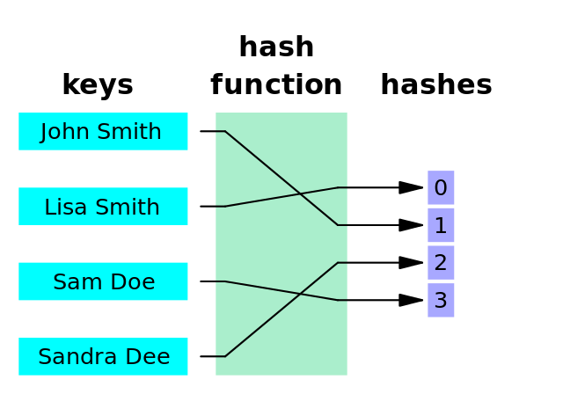
Perfect hash functions
A perfect hash function is a hash function that assigns a unique hash code to every key (no collisions)
A minimal perfect hash function is a perfect hash function that uses every slot in the hash table and wastes no space
Why are hash functions not perfect/minimal?
Because the input space is unlimited – can’t prepare for everything!
What if we knew exactly what data and how much data needs to be stored?
Turns out you can design a perfect hash function if data (input space) is known beforehand!

Slide 5
Cichelli’s Algorithm
An algorithm that constructs a perfect minimal hash function for a set of strings
Suppose we want to store different cities in a hash table:
We are re-inventing google maps: need to store a lot of information about each city, and be able to access it quick
Every city has a unique name: city names can be the keys
The number of cities is predetermined: reserve just enough space (and no extra!) to store them all
Cichelli’s hash function:
length(S) is the length of the string
firstLetter(S) and lastLetter(S) return the values assigned to the first and last letter of the string
Task: Assign values to all first/last characters to create a perfect hash
Johannesburg
Pretoria
Cape Town
Durban
h(S) = [length(S) + firstLetter(S) + lastLetter(S)] % T

Slide 6
Cichelli’s Algorithm
Count the frequencies of first/last characters
Sort the strings based on cumulative frequency (freq(first) + freq(last))
Pretoria
P = 1, A = 1
P = 1 A = 1
J = 1
G = 1
D = 1
N = 2
C = 1
Johannesburg
J = 1, G = 1
Durban
D = 1, N = 1
Cape Town
C = 1, N = 2
Durban
3
Why sort:
Same letters may cause clashes, thus place the words that share letters first
Cape Town
3
Pretoria
2
Johannesburg
2

Slide 7
Cichelli’s Algorithm
assignHash(wordlist)
Remove first word on the list
Choose values for first(w), last(w)
Compute hash(w) = [length(w) + first(w) + last(w)]%T
if(hash is not taken)
use the hash
assignHash(wordlist) // recursive step
else
Go to (II) and try other values for first(w), last(w)
Durban
3
D = 0
0
1
2
3
Cape Town
3
N = 0
Pretoria
2
Durban
Johannesburg
2
h(Durban) = [6 + 0 + 0] % 4 = 2

Slide 8
Cichelli’s Algorithm
assignHash(wordlist)
Remove first word on the list
Choose values for first(w), last(w)
Compute hash(w) = [length(w) + first(w) + last(w)]%T
if(hash is not taken)
use the hash
assignHash(wordlist) // recursive step
else
Go to (II) and try other values for first(w), last(w)
D = 0
0
1
2
3
Cape Town
3
N = 0
Cape Town
Pretoria
2
C = 0
Durban
Johannesburg
2
h(Cape Town) = [9 + 0 + 0] % 4 = 1

Slide 9
Cichelli’s Algorithm
assignHash(wordlist)
Remove first word on the list
Choose values for first(w), last(w)
Compute hash(w) = [length(w) + first(w) + last(w)]%T
if(hash is not taken)
use the hash
assignHash(wordlist) // recursive step
else
Go to (II) and try other values for first(w), last(w)
D = 0
0
1
2
3
Pretoria
N = 0
Cape Town
Pretoria
2
C = 0
Durban
Johannesburg
2
P = 0
A = 0
h(Pretoria) = [8 + 0 + 0] % 4 = 0

Slide 10
Cichelli’s Algorithm
D = 0
0
1
2
3
Pretoria
Johannesburg
2
N = 0
Cape Town
C = 0
Durban
P = 0
Johannesburg
A = 0
J = 0
J = 1
G = 0
G = 1
G = 2
?
MAX = 2
Final:
h(Johannesburg) = [12 + 0 + 0] % 4 = 0
D = 0
h(Johannesburg) = [12 + 0 + 1] % 4 = 1
N = 0
h(Johannesburg) = [12 + 0 + 2] % 4 = 2
C = 0
P = 0
h(Johannesburg) = [12 + 1 + 0] % 4 = 1
A = 0
J = 1
h(Johannesburg) = [12 + 1 + 1] % 4 = 2
G = 2
h(Johannesburg) = [12 + 1 + 2] % 4 = 3

Slide 11
Cichelli’s Algorithm
If values have been assigned to letters, they should be re-used by all words
assignHash(wordlist)
Remove first word on the list
for(first(w) = 0; first(w) < MAX; first(w)++) // unless first(w) has a value
for(last(w) = 0; last(w) < MAX; last(w)++) // unless last(w) has a value
Compute hash(w) = [length(w) + first(w) + last(w)]%T
if(hash(w) not taken)
Put the word in position hash(w)
success = assignHash(wordlist) // recursive step
if(success) return success;
Put word back on the list
Return failure // backtracking
MAX is chosen to be a small value;
# words / 2

Slide 12
Cichelli’s Algorithm
Frequencies:
Anna
A = 4 M = 2
J = 3
E = 1
N = 2
0
1
2
3
4
5
4 + 4 = 8
Maria
2 + 4 = 6
Jane
3 + 1 = 4
John
3 + 2 = 5
Julia
3 + 4 = 7
Megan
2 + 2 = 4
8
Anna
Julia
Assign values to first/last characters!
7
6
Maria
5
John
4
Jane
4
Megan

Slide 13
Cichelli’s Algorithm
MAX = T / 2 = 6 / 2 = 3
Anna
Anna
(4 + 0 + 0) % 6 = 4
Maria
0
1
2
3
4
5
Julia
Julia
(5 + 0 + 0) % 6 = 5
John
Maria
Maria
(5 + 0 + 0) % 6 = 5
X
John
Maria
(5 + 1 + 0) % 6 = 0
Jane
John
(4 + 0 + 0) % 6 = 4
X
John
(4 + 0 + 1) % 6 = 5
X
Anna
Megan
John
(4 + 0 + 2) % 6 = 0
X
Julia
John
(4 + 0 + 3) % 6 = 1
Jane
(4 + 0 + 0) % 6 = 4
X
A = 0
Jane
(4 + 0 + 1) % 6 = 5
X
Nothing else to try – backtrack!
J = 0
Jane
(4 + 0 + 2) % 6 = 0
X
M = 3
Jane
(4 + 0 + 3) % 6 = 1
X
M = 2
M = 1
M = 0
N = 1
Maria
(5 + 2 + 0) % 6 = 1
N = 2
N = 3
N = 0
// John will go to zero, but Jane won’t find a place
E = 3
E = 2
E = 1
E = 0
Maria
(5 + 3 + 0) % 6 = 2
// John will go to zero
// Jane will go to one

Slide 14
Cichelli’s Algorithm
MAX = T / 2 = 6 / 2 = 3
Jane
Anna
Anna
(4 + 0 + 0) % 6 = 4
John
0
1
2
3
4
5
Julia
Julia
(5 + 0 + 0) % 6 = 5
Jane
Maria
Maria
(5 + 3 + 0) % 6 = 2
Maria
John
John
(4 + 0 + 2) % 6 = 0
Jane
Jane
(4 + 0 + 3) % 6 = 1
Megan
(5 + 3 + 2) % 6 = 4
X
Anna
Megan
John
(4 + 0 + 3) % 6 = 1
Julia
Jane
(4 + 0 + 2) % 6 = 0
Megan
(5 + 3 + 3) % 6 = 5
X
A = 0
Julia
(5 + 1 + 0) % 6 = 0
J = 1
J = 0
M = 3
Complexity: exponential
M = 2
Repeat the steps till the perfect hash is created
M = 1
M = 0
N = 3
N = 1
N = 2
N = 0
E = 3
E = 2
E = 1
What is the problem with this approach?
Infeasible for large sets
E = 0
Backtracking can be very time-consuming
What if you had to store Jane and Jade?

